Slide 1
MICROSOFT MOVIE STUDIO
Redefining Cinematic Excellence

Slide 2
Outline
Goal
Data
Methods
Results
Recommendations

Slide 3
Goal
Venturing into the Movie Industry: Microsoft's Profitable Path
Objective: Microsoft's Movie Industry Entry
Analyzing Success Factors: ROI, Genre, Star Appeal
Profitable Rivalry: Unveiling Studio's Success Secrets

Slide 4
Methods
Data Preparation and Cleaning
Acquiring and Organizing Data
Enhancing Data Relevance with SQL
Data Cleaning Process
Converting Financial Values
Eliminating Duplicates and Missing Data
ROI Calculation and Visualization
Introducing ROI Column
Visualizing Data with matplotlib and seaborn

Slide 5
Data
For this project, I utilized data from the following sources:
Box Office Mojo
IMDB, Rotten Tomatoes
TheMovieDB
The Numbers
This data encompasses comprehensive details about movies, such as the key individuals involved in production, genres and financial metrics

Slide 6
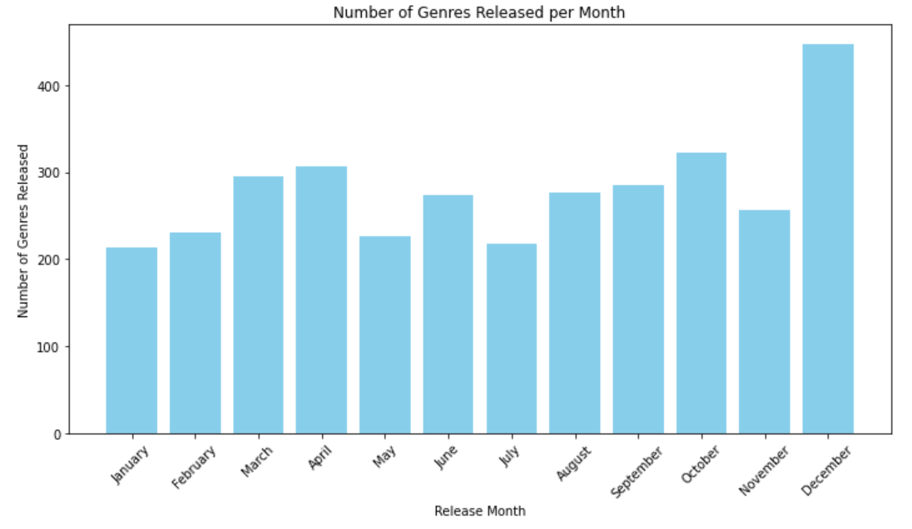
Results
Months with the highest movie releases are December, October, April, March, June, August and November respectively

Slide 7
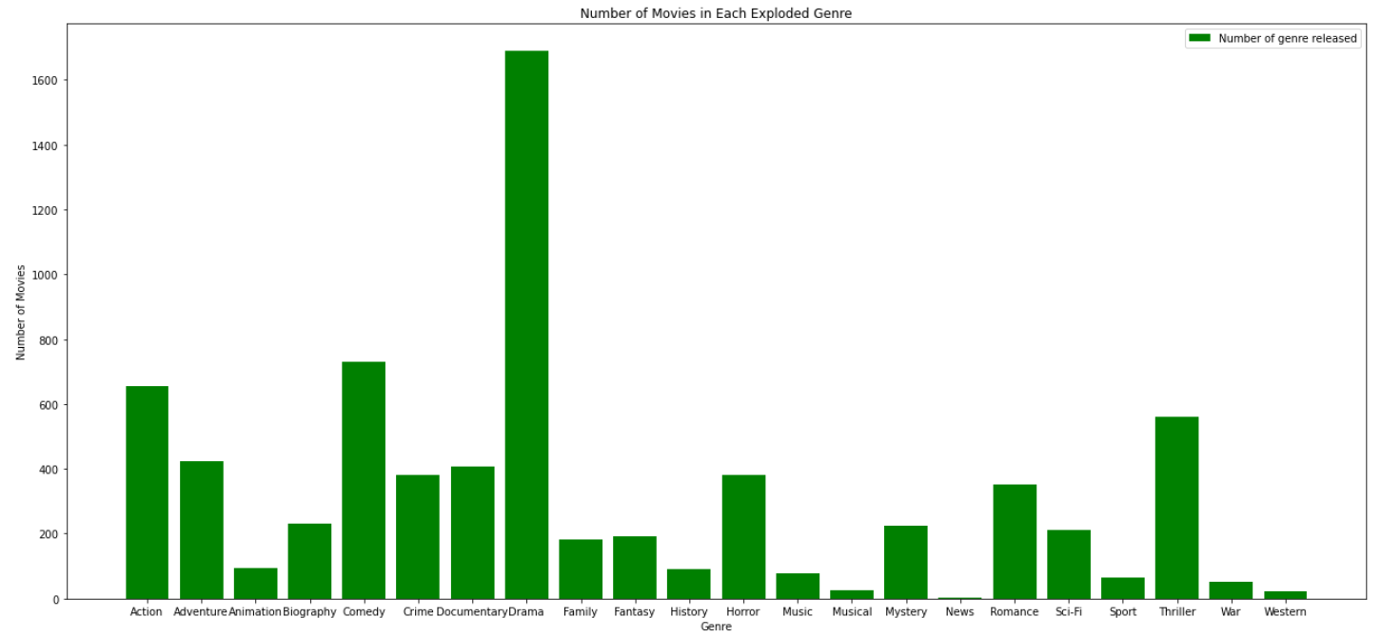
Genre Releases: Drama: Most Releases; Comedy: Second Most; Action: Third Most
Grouped Genre Releases Comedy, DramaDrama, RomanceComedy, Drama, Romance Action, Crime, Drama

Slide 8
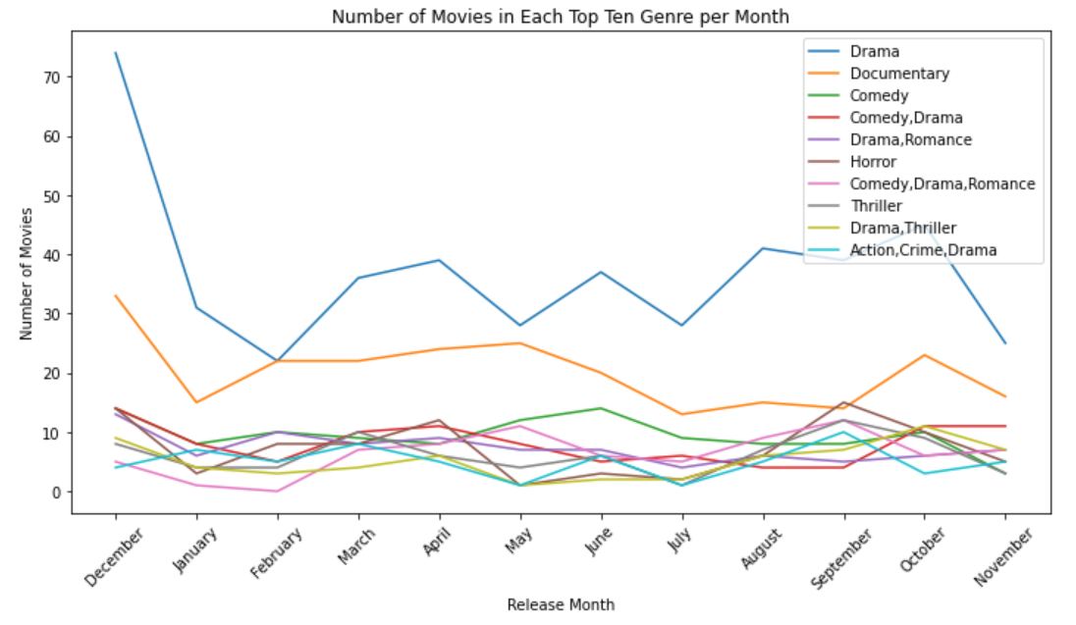

Slide 9
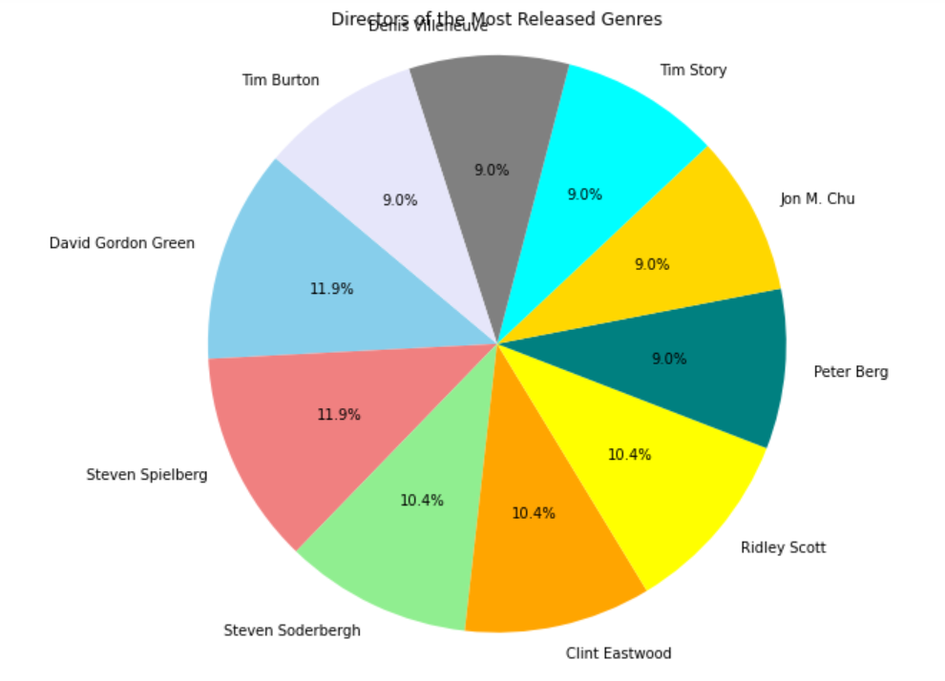
The movie production industry
is dominated by few directors.
These directors produce the most
released genres we earlier identified.

Slide 10
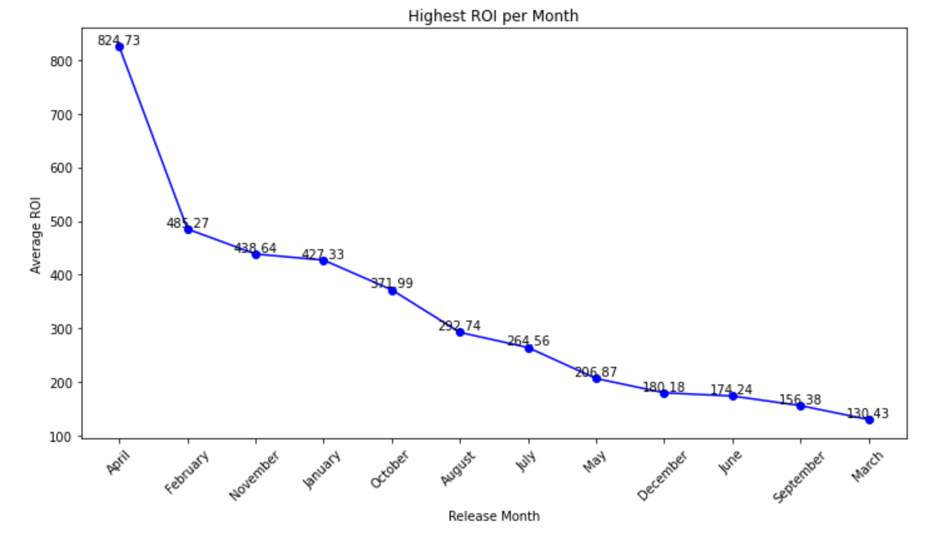
ROI by Month
April: Highest ROI
February: Second Highest
November: Third Highest
April's Success
Genre: Comedy, Drama, Horror
Director: Graham Wright

Slide 11
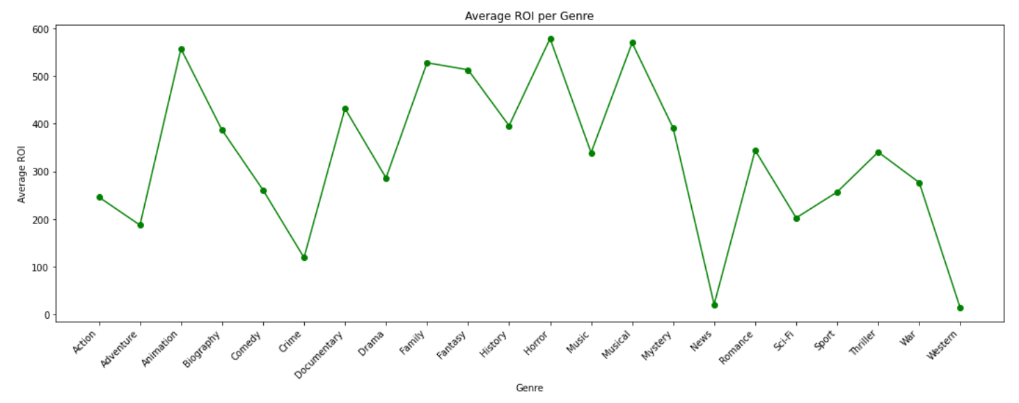
The below line graph reveals that the some of the genres with the highest roi are horror, musical, animation and family. I find this quite strange given that these are not the same genres I find under mostly released genres per month.

Slide 12
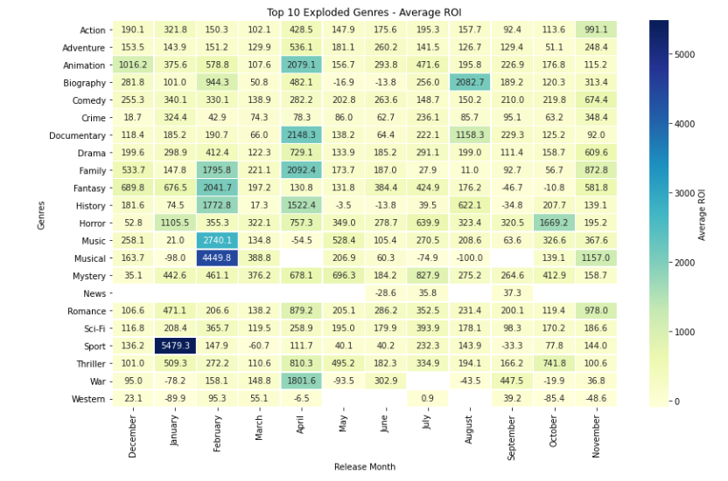
This is a heat map showing
that from a closer look, contrary
to the above line graph, the sport
genre had the highest ROI.
This could be due to the low
investment/budget put in this movie
genre compared to horror.

Slide 13
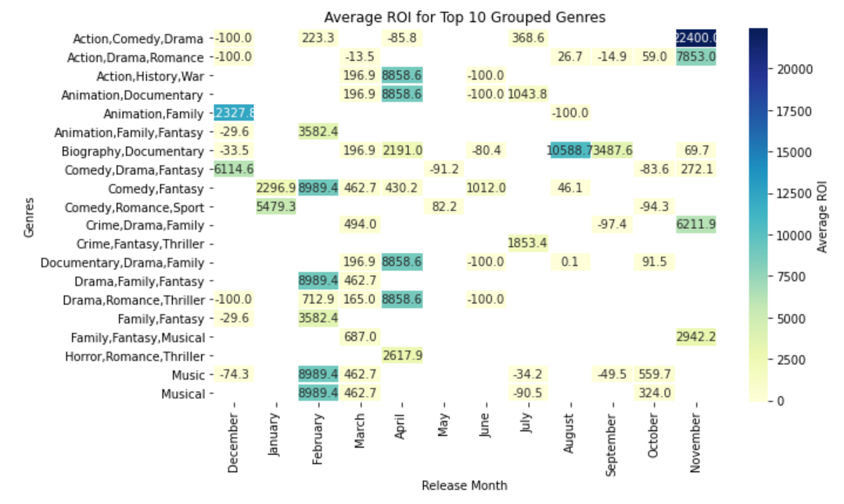
I found that when movies
released have combined genres,
the ROI is much higher. An instance
is where a combination of action,
comedy and drama have the
highest ROI.

Slide 14
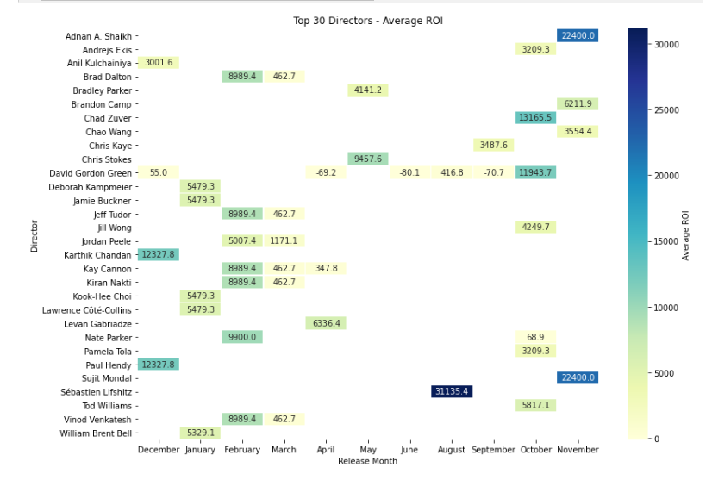
Top 30 Directors with Highest ROI
Directed Movies with Genres: Biography,
Documentary, Action, Comedy, Drama,
Romance, Horror, Animation,
Family, Sport, Fantasy, and Musical.
Main Release Months:
January
February
March
October
November
December

Slide 15
Conclusion
Profitable opportunity in movie industry for Microsoft:
High budget ≠ High ROI
Combined genres = Potential success, best release months: Dec, Nov, Oct
Focus on animation, horror, musicals = High ROI, low budget
Consider experienced directors: S. Soderbergh, S. Spielberg, D. Gordon Green, S. Lifshitz, S. Mondal, A. A. Shaikh, K. Chandan, C. Zuver"

